Slide 1
Unit 2 Process Management and Scheduling

Slide 2
Contents
Process Concepts
Process Scheduling
Operations on Process
Inter- Process Communication
Basic Concepts on Process Scheduling
Scheduling Criteria
Scheduling Algorithms
Algorithm Evaluation
2

Slide 3
Process Concept
Process - An instance of computer program in execution
Some times also called as jobs or task
Batch system – jobs
Time-shared systems – user programs or tasks
Process on modern systems can have several threads of execution or several different pieces of the program running in parallel
Each process has its own private resources, data and associated statistics.
One program can be several processes
Consider multiple users executing the same program
Notes:
difference between process and program
process is a program in execution, program is a set of instruction that can be executed on the computer.

Slide 4
Difference between process and program
A program is a set of instruction and a passive entity.
while a program in execution is a process and it is a active entity.
process is a unit of work in a system.
program is a part of process.

Slide 5
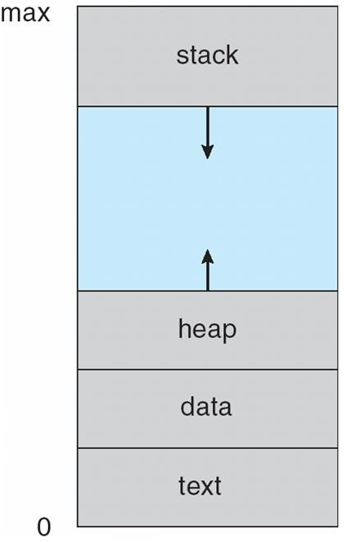
Process in memory
In memory, a process consists of multiple parts:
Program code, also called text section
Stack containing temporary data
Function parameters, return addresses, local variables
Data section containing global variables
Heap containing memory dynamically
allocated during run time
5

Slide 6
Process State
As a process executes, it changes state
new: The process is being created
running: Instructions are being executed
waiting: The process is waiting for some event t o occur
ready: The process is waiting to be assigned to a processor
terminated: The process has finished execution
6

Slide 7
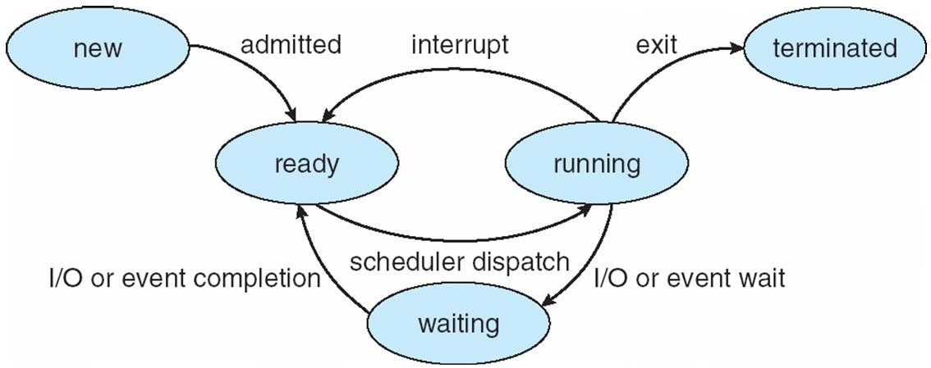
Diagram of Process State
7

Slide 8
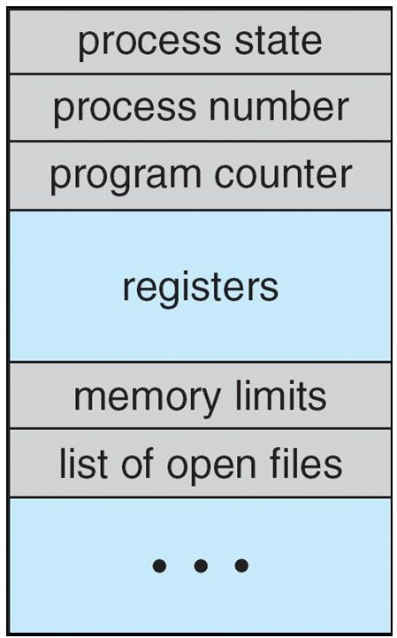
Process Control Block (PCB)
Information associated with each process
Process state – new, ready, running…
Process Number – process id, parent process id
Program counter – next instr. for exec
CPU registers – no. and type of reg.used
Memory-management information
Limit of page table and segment table
Accounting information
Amt of CPU time used, time limit
I/O status information
List of I/O devices
8

Slide 9
Process Concepts - Threads
Threads – lightweight process
So far, process has a single thread of execution
One task at a time
Consider having multiple program counters per process
Multiple locations can execute at once
Multiple tasks at a time
P C B must be extended to handle threads:
Store thread details
Multiple program counters
9

Slide 10
Process Scheduling
The act of determining which process in the ready state should be moved to the running state is known as Process Scheduling.
The prime aim of the process scheduling system is to keep the CPU busy all the time and to deliver minimum response time for all programs.
For achieving this, the scheduler must apply appropriate rules for swapping processes IN and OUT of CPU.

Slide 11
Process Scheduling
Schedulers fell into one of the two general categories :
Non pre-emptive scheduling. When the currently executing process gives up the CPU voluntarily.
Pre-emptive scheduling. When the operating system decides to favour another process, pre-empting the currently executing process.

Slide 12
Process Scheduling
Maximize CPU use, quickly switch processes onto CPU for time sharing
Process scheduler selects among available processes for next execution on CPU
Scheduling Queues
Schedulers
Context Switch
Process Scheduling – Scheduling Queues
Process Maintains scheduling queues of processes
Job queue – set of all processes in the system
Ready queue – set of all processes residing in main memory, ready and waiting to execute
Device queues – set of processes waiting for an I/O device
Processes migrate among the various queues
9
Queue is generally stored as linked list

Slide 13
Scheduling Queues
All processes when enters into the system are stored in the job queue.
Processes in the Ready state are placed in the ready queue.
Processes waiting for a device to become available are placed in device queues.
There are unique device queues for each I/O device available.

Slide 14
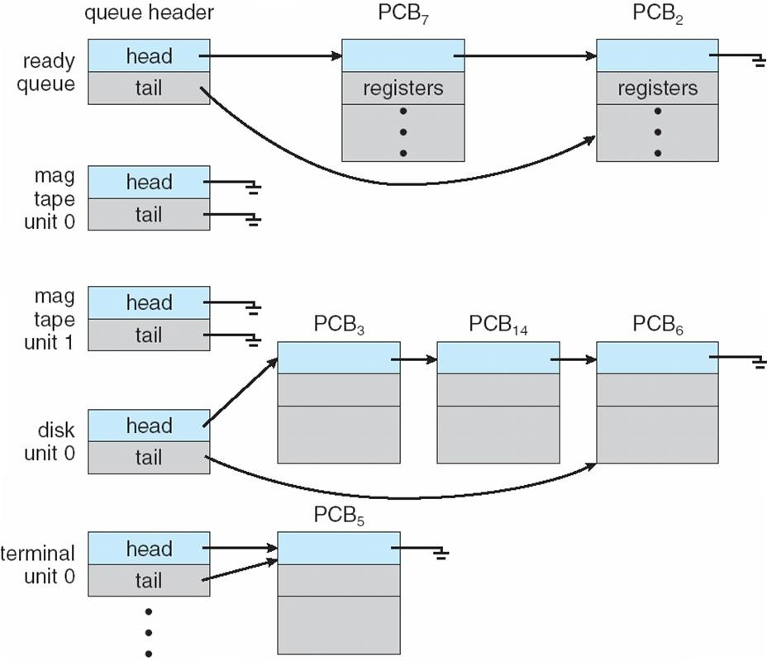
Ready Queue And Various I/O Device Queues

Slide 15
A new process is initially put in the ready queue. It waits in the ready queue until it is selected for execution(or dispatched).
Once the process is assigned to the CPU and is executing, one of several events could occur.
The process could issue an I/O request, and then be placed in an I/O queue.
The process could create a new subprocess and wait for its termination.
The process could be removed forcibly from the CPU, as a result of an interrupt, and be put back in the ready queue.

Slide 16
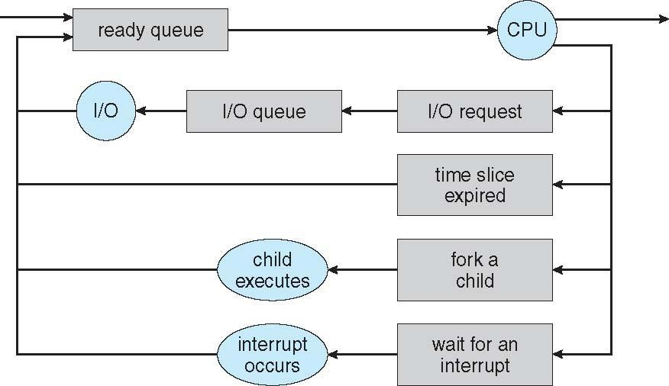
Representation of Process Scheduling

Slide 17
Process Scheduling- Schedulers
Long-term scheduler (or job scheduler) – selects which processes should be brought into the ready queue
Short-term scheduler (or CPU scheduler) – selects which process should be executed next and allocates CPU
Sometimes the only scheduler in a system
The Schedulers will implement scheduling policies.

Slide 18
Schedulers (Cont.)
Short-term scheduler is invoked very frequently (milliseconds)
⇒ (must be fast)
Long-term scheduler is invoked very infrequently (seconds, minutes) ⇒ (may be slow)
The long-term scheduler controls the degree of multiprogramming.
Processes can be described as either:
I/O-bound process – spends more time doing I/O than computations, many short CPU bursts
CPU-bound process – spends more time doing computations; few very long CPU bursts

Slide 19
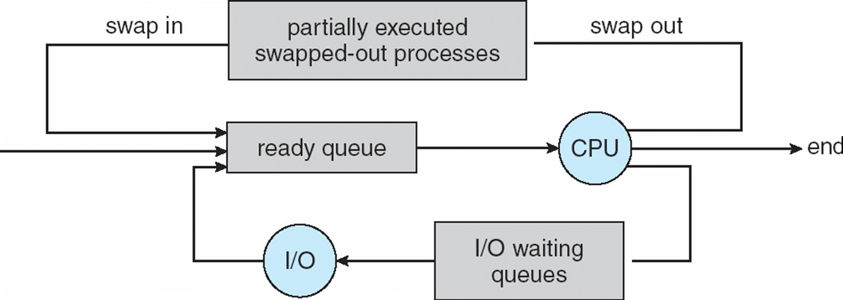
Addition of Medium Term Scheduling
Medium-term scheduler (or job scheduler) – removes process from memory so that reduce the degree of multiprogramming. Later, it reintroduces in main memory. i.e, it takes care of swapping process

Slide 20
Process Scheduling - Context Switch
When CPU switches to another process, the system must save the state of the old process and load the saved state for the new process via a context switch.
Context of a process represented in the PCB
Context-switch time is overhead; the system does no useful work while switching

Slide 21
Switching the CPU to another process requires saving the state of the old process and loading the saved state for the new process. This task is known as a context switch.
The context of a process is represented in the Process Control Block(PCB) of a process; it includes the value of the CPU registers, the process state and memory-management information.
Context switch time is pure overhead, because the system does no useful work while switching. Its speed varies from machine to machine, depending on the memory speed.
Typical speeds range from 1 to 1000 microseconds.

Slide 23
Operations on Processes
A process in most of the systems can execute concurrently, and they must be created & deleted dynamically.Thus, these Systems must provide mechanism for
Process Creation
Process Deletion

Slide 24
Process Creation
A process may create several new processes, via a create-process system call, during the course of execution.
The creating process is called a parent process, and the new processes are called the children of that process.
Each of these new processes may in turn create other processes, forming a tree of processes.

Slide 25
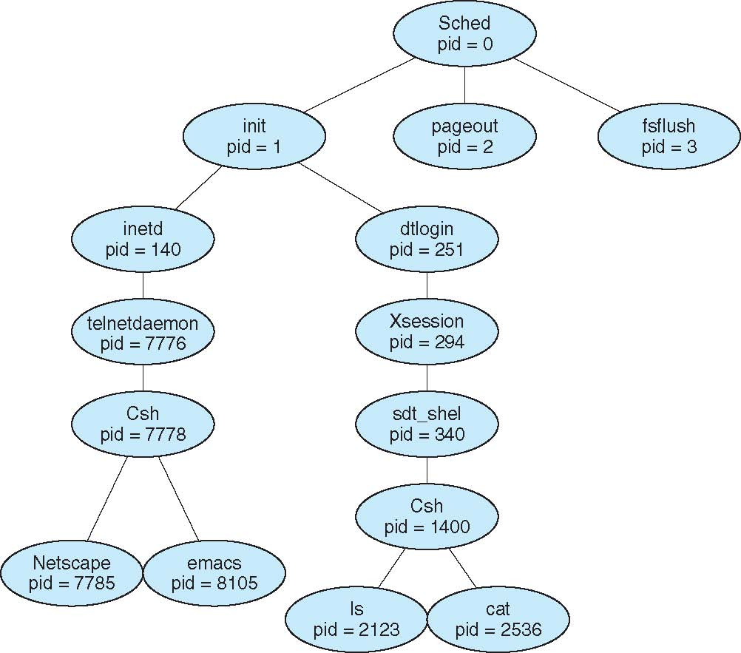
A Tree of Processes on Solaris

Slide 26
Process Creation
A (parent) process can create several (children) processes
Children can, in turn, create other processes
Hence, a tree of processes forms
Generally, process identified and managed via a process identifier (pid)
Resource sharing options (of process creation)
Parent and children share all resources
Children share subset of parent’s resources
Parent and child share no resources
Execution options
Parent and children execute concurrently
Parent waits until children terminate

Slide 27
Process Creation
Address space options
Child duplicate of parent
Child has a program loaded into it
UNIX examples
fork() system call creates new process
Child is a copy of parent’s address space
except fork() returns 0 to child and nonzero to parent
exec() system call used after a fork() to replace the process’ memory space with a new program
20

Slide 28
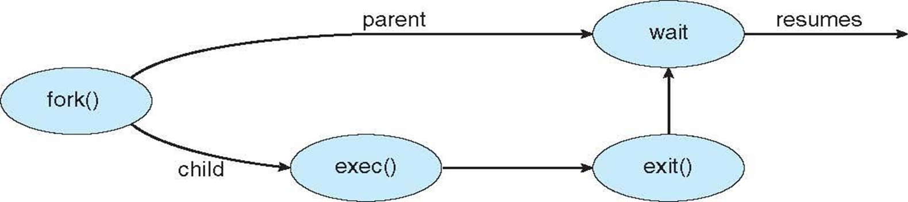
Process creation using fork() system call.

Slide 29
Understanding fork() system call for new process creation
main()
{
fork();
fork();
printf("hi");
}

Slide 30
Creating a separate process using the UNIX fork() system call.
#include <sys/types.h>
#include <studio.h>
#include <unistd.h>
int main()
{
pid_t pid;
/* fork another process */
pid = fork();
if (pid < 0) { /* error occurred */
fprintf(stderr, "Fork Failed");
return 1;
}
else if (pid == 0) { /* child process */
execlp("/bin/ls", "ls", NULL);
}
else { /* parent process */
/* parent will wait for the child */
wait (NULL);
printf ("Child Complete");
}
return 0;
}

Slide 31
Process Termination
Process executes last statement and then asks the operating system to delete it using the exit() system call.
Returns status data from child to parent (via wait())
Process’ resources are deallocated by operating system
Parent may terminate the execution of children processes using the
abort() system call. Some reasons for doing so:
Child has exceeded allocated resources
Task assigned to child is no longer required
The parent is exiting and the operating systems does not allow a child to continue if its parent terminates

Slide 32
Process Termination
Some OS’s don’t allow child to exists if its parent has terminated
cascading termination - if a process terminates, then all its children, grandchildren, etc must also be terminated.
The termination is initiated by the operating system
The parent process may wait for termination of a child process by using the
wait() system call.
The call returns status information and the pid of the terminated process
pid = wait(&status);
If parent terminated without invoking wait , process is an orphan
Process finished its execution but the state not changed is a zombie

Slide 33
Inter Process Communication
Processes within a system may be independent or cooperating
When processes execute they produce some computational results
Independent process cannot affect (or be affected) by results of another process
Cooperating process can affect (or be affected) by results of another process
Advantages of process cooperation
Information sharing
Computation speed-up
Modularity
Convenience

Slide 34
-contd..
For fast exchange of information, cooperating processes need some
interprocess communication (IPC) mechanisms
Two models of IPC
Shared memory
Message passing

Slide 35
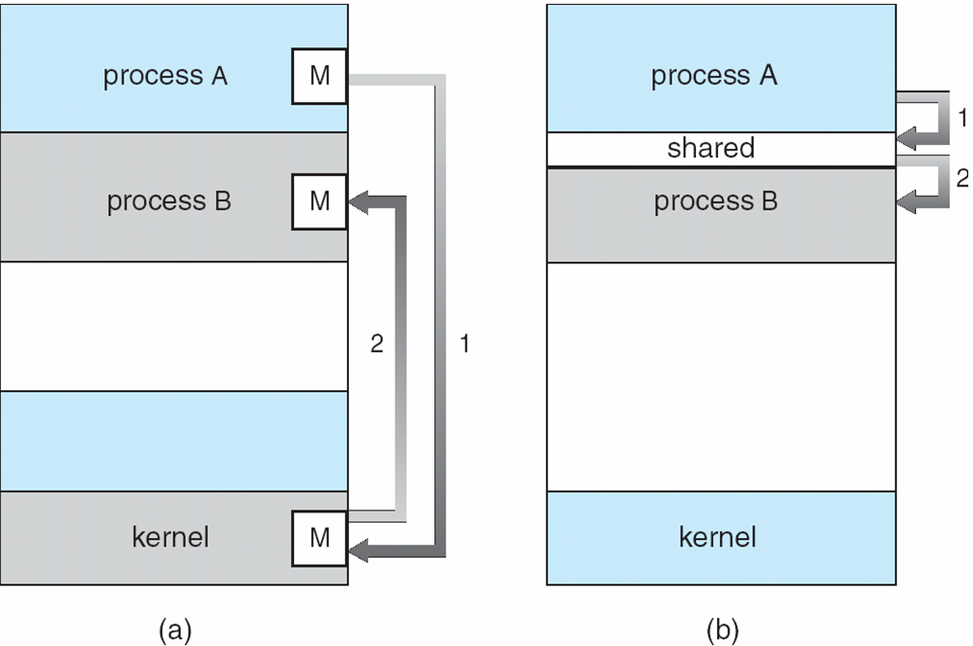
Communications Models (a)Message passing (b) Shared memory

Slide 36
IPC – Shared Memory Systems
An area of memory is shared among the processes that wish t o communicate
The communication is under the control of the users processes, not the OS.
Major issue is to provide mechanism that will allow the user processes to synchronize their actions when they access shared memory.

Slide 37
IPC – Shared Memory Systems
Producer-consumer problem – a common paradigm for cooperating processes
Producer process : produces some information
Consumer process : consumes this information
Challenge:
Producer and consumer should run concurrently and efficiently
Producer and consumer must be synchronized
Consumer cannot consume an item before it is produced
Shared-memory is solution to producer-consumer
Uses a buffer in shared memory to exchange information
unbounded-buffer assumes no practical limit on the buffer size
bounded-buffer assumes a fixed buffer size

Slide 38
Bounded-Buffer – Shared-Memory Solution
Shared data
#define BUFFER_SIZE 10
typedef struct {
. . .
} item;
item buffer[BUFFER_SIZE];
int in = 0;
int out = 0;
Solution is correct, but can only use BUFFER_SIZE-1 elements

Slide 39
Bounded-Buffer – Producer
while (true) { /* Produce an item */
while (((in = (in + 1) % BUFFER SIZE count) == out)
; /* do nothing -- no free buffers */
buffer[in] = item;
in = (in + 1) % BUFFER SIZE;
}

Slide 40
Bounded Buffer – Consumer
while (true) {
while (in == out)
; // do nothing -- nothing to consume
// remove an item from the buffer
item = buffer[out];
out = (out + 1) % BUFFER SIZE;
return item;
}

Slide 41
IPC--Message Passing
Mechanism for processes to communicate and to synchronize their actions
Message system – processes communicate with each other without resorting to shared variables
IPC facility provides two operations:
send(message) – message size fixed or variable
receive(message)
If P and Q wish to communicate, they need to:
establish a communication link between them
exchange messages via send/receive
Implementation of communication link
physical (e.g., shared memory, hardware bus)
logical (e.g., logical properties)

Slide 42
Implementation Questions
How are links established?
Can a link be associated with more than two processes?
How many links can there be between every pair of communicating processes?
What is the capacity of a link?
Is the size of a message that the link can accommodate fixed or variable?
Is a link unidirectional or bi-directional?

Slide 43
Direct Communication
Processes must name each other explicitly:
send (P, message) – send a message to process P
receive(Q, message) – receive a message from process Q
Properties of communication link
Links are established automatically
A link is associated with exactly one pair of communicating processes
Between each pair there exists exactly one link
The link may be unidirectional, but is usually bi-directional

Slide 44
Indirect Communication
Messages are directed and received from mailboxes (also referred to as ports)
Each mailbox has a unique id
Processes can communicate only if they share a mailbox
Properties of communication link
Link established only if processes share a common mailbox
A link may be associated with many processes
Each pair of processes may share several communication links
Link may be unidirectional or bi-directional

Slide 45
Indirect Communication
Operations
create a new mailbox
send and receive messages through mailbox
destroy a mailbox
Primitives are defined as:
send(A, message) – send a message to mailbox A
receive(A, message) – receive a message from mailbox A

Slide 46
Indirect Communication
Mailbox sharing
P₁, P₂, and P₃ share mailbox A
P₁, sends; P₂ and P₃ receive
Who gets the message?
Solutions
Allow a link to be associated with at most two processes
Allow only one process at a time to execute a receive operation
Allow the system to select arbitrarily the receiver. Sender is notified who the receiver was.

Slide 47
IPC – Message Passing - Synchronization
Message passing may be either
Blocking, or
Non-blocking
Blocking is considered synchronous
Blocking send -- the sender is blocked until the message is received
Blocking receive -- the receiver is blocked until a message is available
Non-blocking is considered asynchronous
Non-blocking send -- the sender sends the message and continues sending
Non-blocking receive -- the receiver receives:
A valid message, or
Null message
Different combinations possible
If both send and receive are blocking – called a rendezvous

Slide 48
IPC – Message Passing - Buffering
Whether communication is direct or indirect, messages exchanged by communicating processes reside in a temporary queue. Basically, such queues can be implemented in three ways:
Zero capacity – no messages are queued on a link.
- Sender must wait for receiver
Bounded capacity – finite length of n messages
Sender must wait if link full
Unbounded capacity – infinite length
Sender never waits

Slide 49



































Basics Concepts in Process Scheduling
Maximum CPU utilization obtained with multiprogramming
waiting for I/O is wasteful
1 thread will utilize only 1 core
CPU–I/O Burst Cycle
Process execution consists of:
a cycle of CPU execution
and I/O wait
CPU burst followed by I/O burst
CPU burst distribution is of main concern

Slide 50
CPU Scheduler
Short-term scheduler
Selects 1 process from the ready queue
then allocates the CPU to it
Queue may be ordered in various ways : FIFO Queue, Priority Queue, tree, linked list
CPU scheduling decisions may take place when a process:
Switches from running to waiting state
Switches from running to ready state
Switches from waiting to ready
Terminates
Scheduling under 1 and 4 is called nonpreemptive (=cooperative)
All other scheduling is called preemptive
Process can be interrupted and must release the CPU

Slide 51
Dispatcher
A module that gives control of the CPU to the process selected by the short-term scheduler; this involves:
switching context
switching to user mode
jumping to the proper location in the user program to restart that program
Dispatch latency
Time it takes for the dispatcher to stop one process and start another running
This time should be as small as possible

Slide 52
Scheduling Criteria
How do we decide which scheduling algorithm is good?
Many criteria for judging this has been suggested
Which characteristics considered can change significantly which algorithm is considered the best
CPU utilization – keep the CPU as busy as possible
Throughput – Number of processes that complete their execution per time unit
Turnaround time – amount of time to execute a particular process
Waiting time – amount of time a process has been waiting in the ready queue
Response time – amount of time it takes to start responding
Used for interactive systems
Time from when a request was submitted until the first response is produced

Slide 53
Scheduling Criteria
Scheduling Algorithm Optimization Criteria
Max CPU utilization
Max throughput
Min turnaround time
Min waiting time
Min response time

Slide 54
Scheduling Algorithm
There are Five popular process scheduling algorithms
First-Come, First-Served (FCFS) Scheduling
Shortest-Job-First (SJF) Scheduling
Priority Scheduling
Round Robin(RR) Scheduling
Multiple-Level Queues Scheduling
These algorithms are either non-preemptive or preemptive.
Non-preemptive algorithms are designed so that once a process enters the running state, it cannot be preempted until it completes its allotted time.
whereas the preemptive scheduling is based on priority where a scheduler may preempt a low priority running process anytime when a high priority process enters into a ready state.

Slide 55
First Come First Serve (FCFS)
Jobs are executed on first come, first serve basis.
It is a non-preemptive.
Easy to understand and implement.
Its implementation is based on FIFO queue.
Poor in performance as average wait time is high.

Slide 56
Scheduling Algorithm
First- Come, First-Served (FCFS) Scheduling
Process Burst Time
P₁ 24
P₂ 3
P₃ 3
 Suppose that the processes arrive in the order: P₁ , P₂ , P₃
The Gantt Chart for the schedule is:
P₁ | P₂ | P₃
0
Waiting time for P₁ = 0; P₂ = 24; P₃ = 27
Average waiting time: (0 + 24 + 27)/3 = 17
24
27
30

Slide 57
FCFS Scheduling (Cont.)
Suppose that the processes arrive in the order:
P₂ , P₃ , P₁
The Gantt chart for the schedule is:
P₂ | P₃ | P₁
0 3 6
Waiting time for P₁ = 6;P₂ = 0; P₃ = 3
Average waiting time: (6 + 0 + 3)/3 = 3
Much better than previous case
Hence, average waiting time of FCFS not minimal
And it may vary substantially
FCFS is nonpreemptive
Not a good idea for timesharing systems
FCFS suffers from the convoy effect, shorter job to wait for a longer time
30

Slide 58
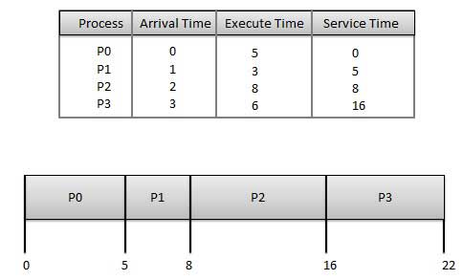
Problem-2
Wait time of each process is as follows −
Average Wait Time: (0+4+6+13) / 4 = 5.75

Slide 59
Shortest-Job-First (SJF) Scheduling
Associate with each process the length of its next CPU burst
Use these lengths to schedule the process with the shortest time
SJF is optimal – gives minimum average waiting time for a given set of processes
The difficulty is knowing the length of the next CPU request
Could ask the user

Slide 60
Scheduling Algorithm Example of SJF
Process | Burst Time
P₁ | 6
P₂ | 8
P₃ | 7
P₄ | 3
 SJF scheduling chart
P₄ | P₁ | P₃ | P₂
0 3 9 16
 Average waiting time = (3 + 16 + 9 + 0) / 4 = 7
24
60

Slide 61
Example of Shortest-remaining-time-first
Now we add the concepts of varying arrival times and preemption to the analysis
ProcessA arri Arrival TimeT Burst Time
P₁ 0 8
P₂ 1 4
P₃ 2 9
P₄ 3 5
Preemptive SJF Gantt Chart
Average waiting time = [(10-1)+(1-1)+(17-2)+5-3)]/4 = 26/4 = 6.5 msec
P₁
P₂
P₄
P₁
P₃
0
1
5
10
17
26

Slide 62
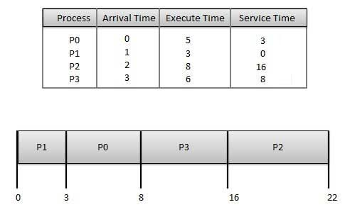
Problem-2
Average Wait Time: (3+0+14+5) / 4 = 5.50

Slide 63
Priority Scheduling
A priority number (integer) is associated with each process
The CPU is allocated to the process with the highest priority (smallest integer ≡ highest priority)
Preemptive
Non preemptive
SJF is priority scheduling where priority is the inverse of predicted next CPU burst time
Problem ≡ Starvation(indefinite blocking) – low priority processes may never execute.
Solution ≡ Aging – as time progresses increase the priority of the process
63

Slide 64
Starvation and Aging
Starvation or indefinite blocking is phenomenon associated with the Priority scheduling algorithms, in which a process ready to run for CPU can wait indefinitely because of low priority. In heavily loaded computer system, a steady stream of higher-priority processes can prevent a low-priority process from ever getting the CPU.
Solution to Starvation : Aging
Aging is a technique of gradually increasing the priority of processes that wait in the system for a long time.
For example, if priority range from 127(low) to 0(high), we could increase the priority of a waiting process by 1 Every 15 minutes. Eventually even a process with an initial priority of 127 would take no more than 32 hours for priority 127 process to age to a priority-0 process.

Slide 65
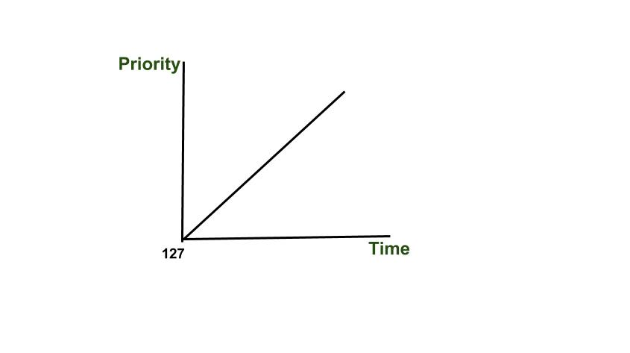
Aging

Slide 66
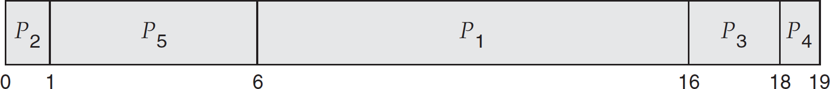
Priority Scheduling Algorithm
Process | Burst Time | Priority
P₁ | 10 | 3
P₂ | 1 | 1
P₃ | 2 | 4
P₄ | 1 | 5
P₅ | 5 | 2
 Priority scheduling Gantt Chart
 Average waiting time = 8.2 msec
66

Slide 67
Round Robin (RR) Algorithm
Each process gets a small unit of CPU time
Time quantum q
Usually 10-100 milliseconds
After this time has elapsed:
The process is preempted and
added to the end of the ready queue
The process might run for ≤ q time
If
n processes in the ready queue, and
the time quantum is q
then
“Each process gets 1/n of the CPU time”
Each process waits ≤ (n-1)q time units
67

Slide 68
Example of RR with Time Quantum = 4
Process Burst Time
P₁ 24
P₂ 3
P₃ 3
The Gantt chart is:
P₁ | P₂ | P₃ | P₁ | P₁ | P₁ | P₁ | P₁
0
4
7
10
14
18
22
26
30
Typically:
Higher average turnaround (end-to-end running time) than SJF
But better response than SJF
68

Slide 69
Scheduling Algorithm - Multilevel Queue
Another class of scheduling algorithms when processes are classified into groups, for example:
foreground (interactive) processes
background (batch) processes
Ready queue is partitioned into separate queues, e.g.:
Foreground and background queues
Process is permanently assigned to one queue
Each queue has its own scheduling algorithm, e.g.:
foreground – RR
background – FCFS
69

Slide 70
Scheduling Algorithm - Multilevel Queue
Scheduling must be done between the queues: Fixed priority scheduling
For example, foreground queue might have absolute priority over background queue
Serve all from foreground then from background
May lead to starvation Time slice Scheduling
Each queue gets a certain amount of CPU time which it can schedule amongst its processes, e.g.:
80% to foreground in RR
20% to background in FCFS
70

Slide 71
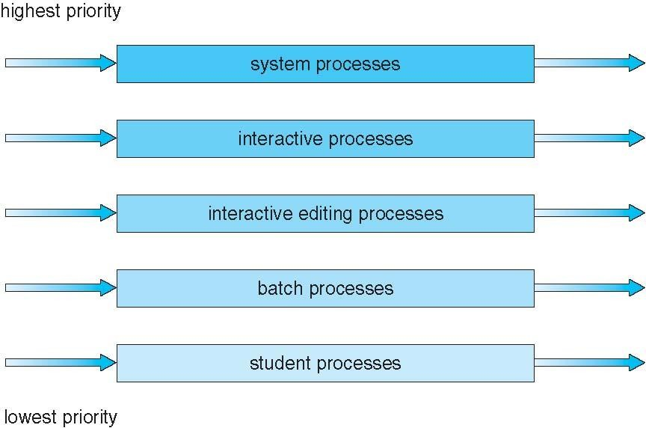
Scheduling Algorithm - Multilevel Queue
71

Slide 72
Scheduling Algorithm - Multilevel Feedback Queue
The previous setup: a process is permanently assigned to one queue
Advantage: Low scheduling overhead
Disadvantage: Inflexible
Multilevel-feedback-queue scheduling algorithm
Allows a process to move between the various queues
More flexible
Idea: separate processes based on the characteristics of their CPU bursts
If a process uses too much CPU time => moved to lower-priority queue
Keeps I/O-bound and interactive processes in the high-priority queue
A process that waits too long can be moved to a higher priority queue
This form of aging can prevent starvation
72

Slide 73
Scheduling Algorithm - Multilevel Feedback Queue
Multilevel-feedback-queue scheduler defined by the following parameters:
number of queues
scheduling algorithms for each queue
method used to determine when to upgrade a process
method used to determine when to demote a process
method used to determine which queue a process will enter when that process needs service
Multilevel-feedback-queue scheduler
The most general CPU-scheduling algorithm
It can be configured to match a specific system under design
Unfortunately, it is also the most complex algorithm
Some means are needed to select values for all the parameters
73

Slide 74
Scheduling Evaluation
How to select CPU-scheduling algorithm for an OS?
Determine criteria, then evaluate algorithms
Evaluation Methods
Deterministic modeling
Queuing models
Simulations
Implementation
74

